Slide 1
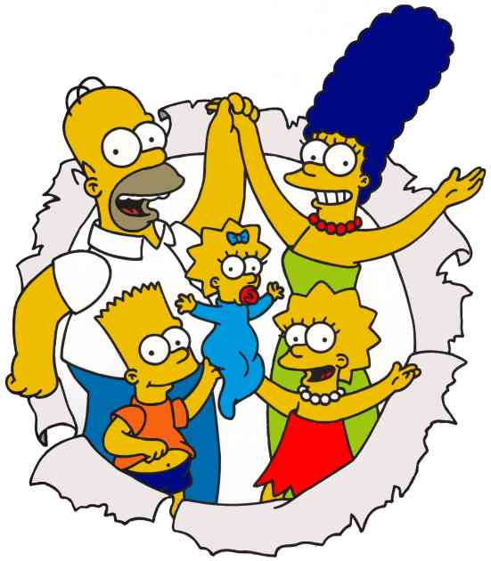
SIMPSONS

Slide 2
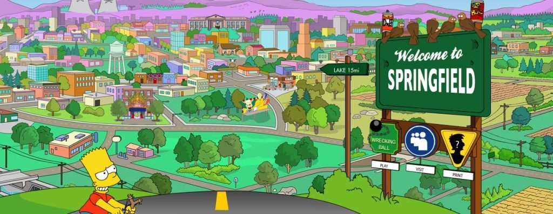
'The Simpsons' is a very popular TV show, not just in America but all over the world. It is about a funny cartoon family from Springfield, USA.

Slide 3
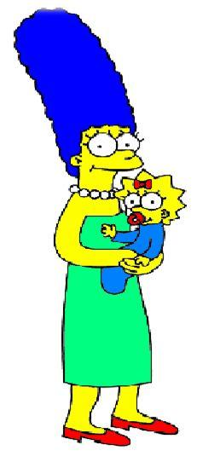
MOTHER
Marge Simpson is the mother of the family.
She is 38 years old.
She is tall and slim
and her hair is blue!
She can cook well
and she is very patient and kind.
she is afraid of flying.

Slide 4
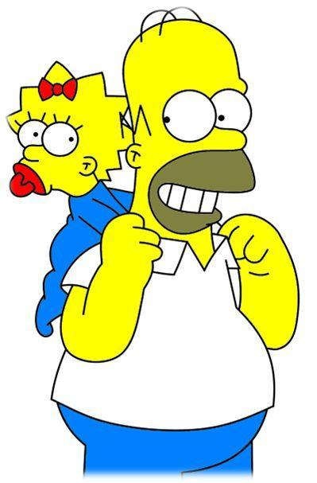
FATHER
Homer Simpson is the father of the family.
He is 39 years and is tall and fat.
He likes eating and drinking very much.
He is not very clever, but he's funny.

Slide 5
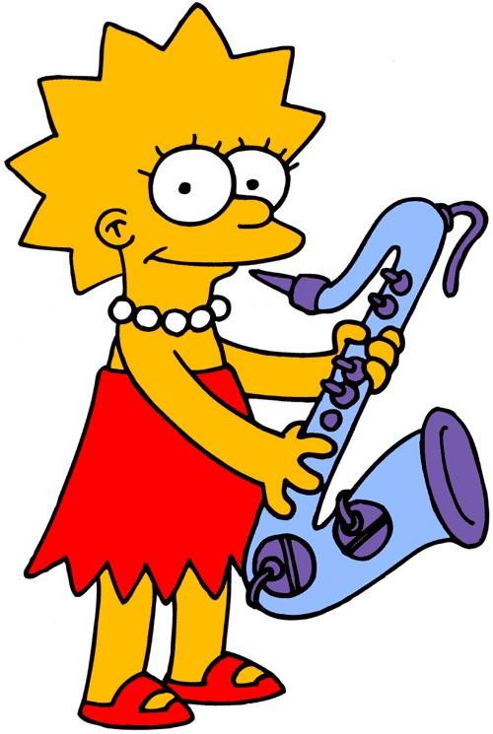
SISTER
Lisa Simpson is 8 years old. She's short and she's got fair hair.
She is very clever. She can sing and play the saxophone and she can speak Swedish and French.

Slide 6
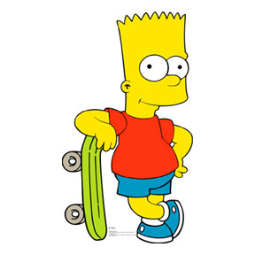
BROTHER
Bart Simpson is 10 years old. He is short with fair hair. He is naughty and noisy.
He likes comic books and skateboarding. He can speak French. He has two sisters, Lisa and Maggie.

Slide 7
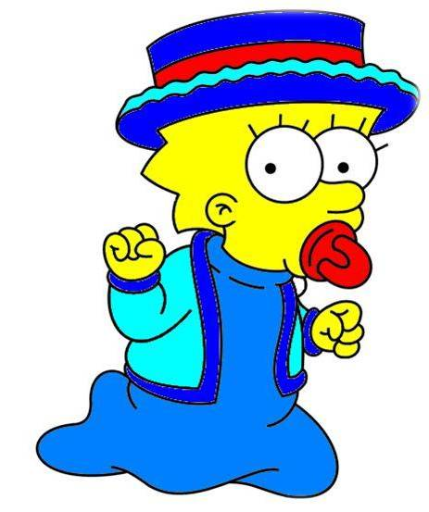
SECOND SISTER
Maggie Simpson is the baby of the family. She is small and she has got fair hair. She can't walk and she can't talk, but she can play the saxophone.
She is quiet, friendly and very clever.

Slide 8
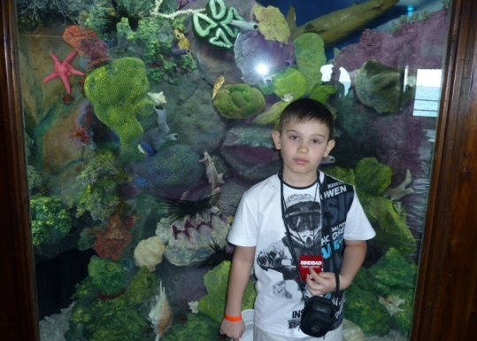
GOOD BYE

